Slide 1
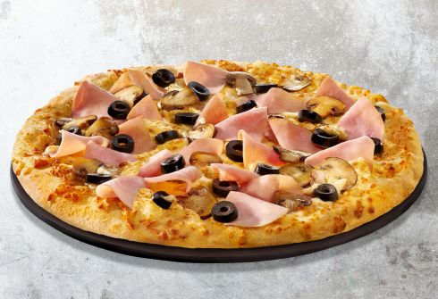
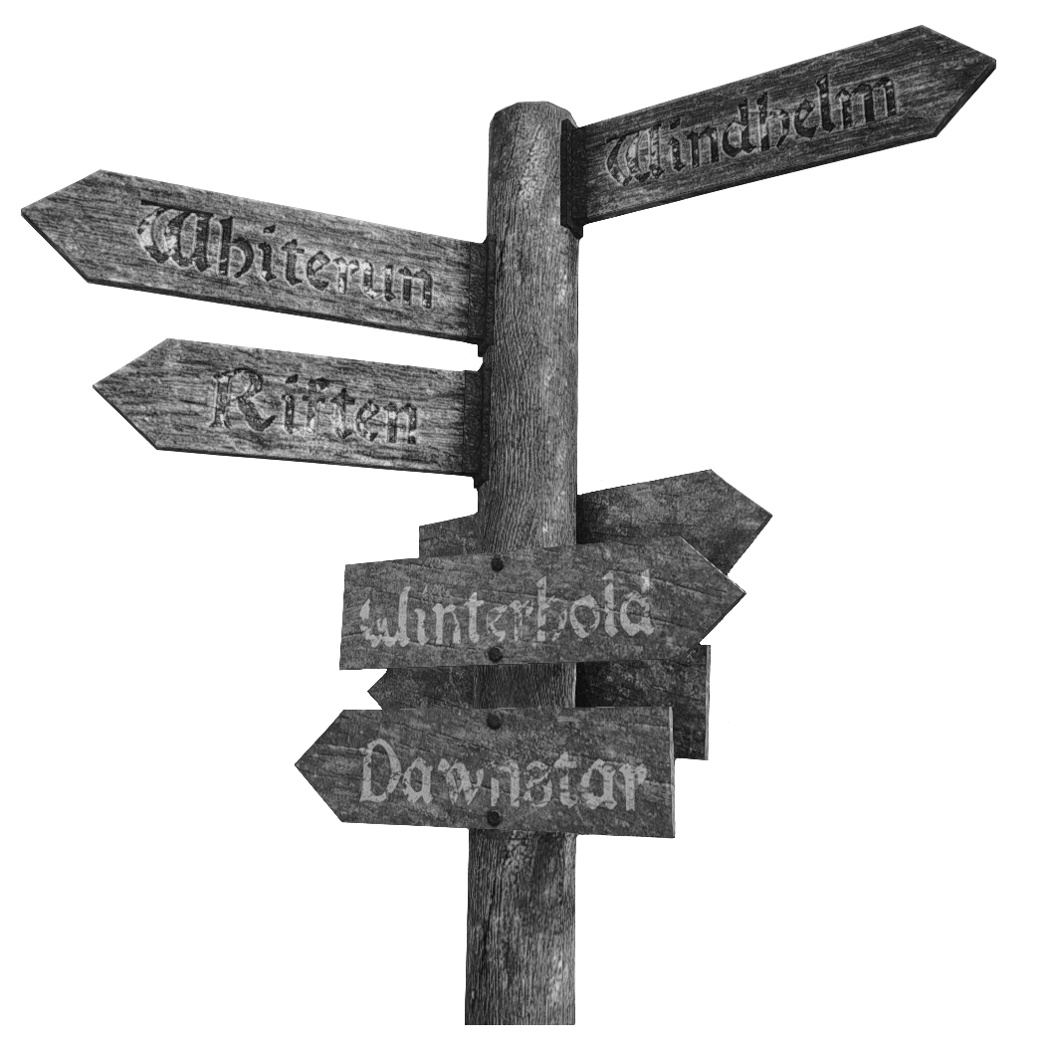
PIZZA Junction

Slide 2
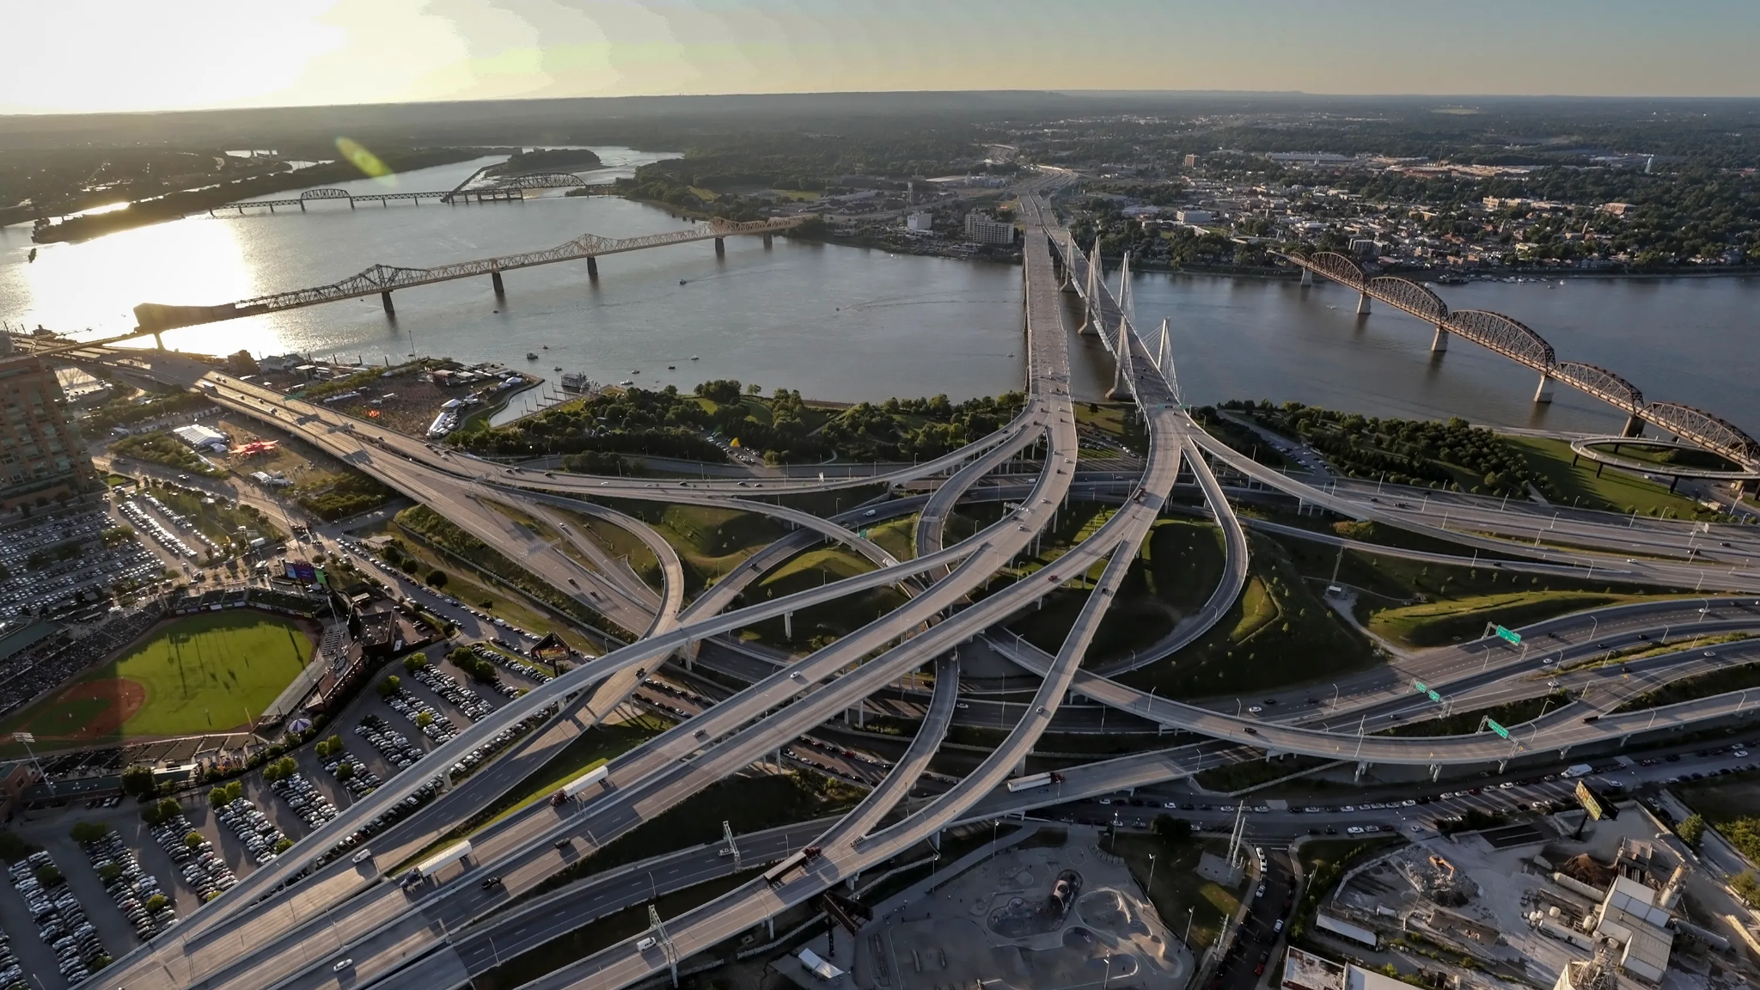

Slide 3
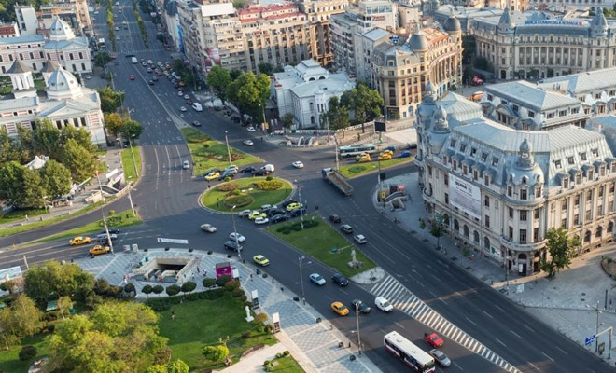

Slide 4
44% of the roads in Romania are not asphalted
In most of the country, a km of road costs almost 2 mil. RON
According to Wikipedia, in the last ten years, corruption doubled in our country

Slide 5
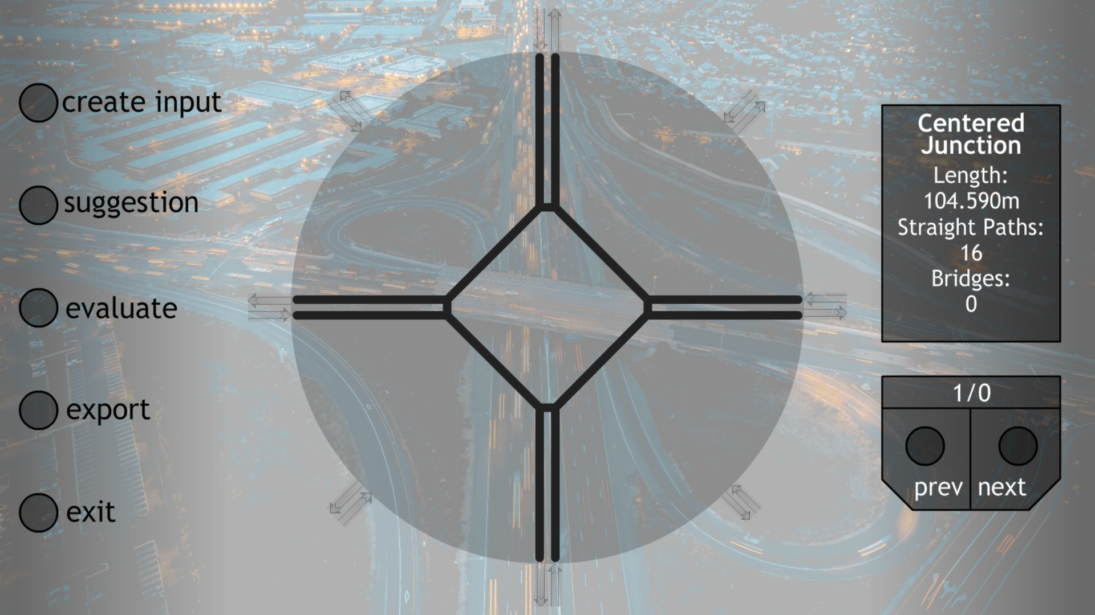

Slide 6
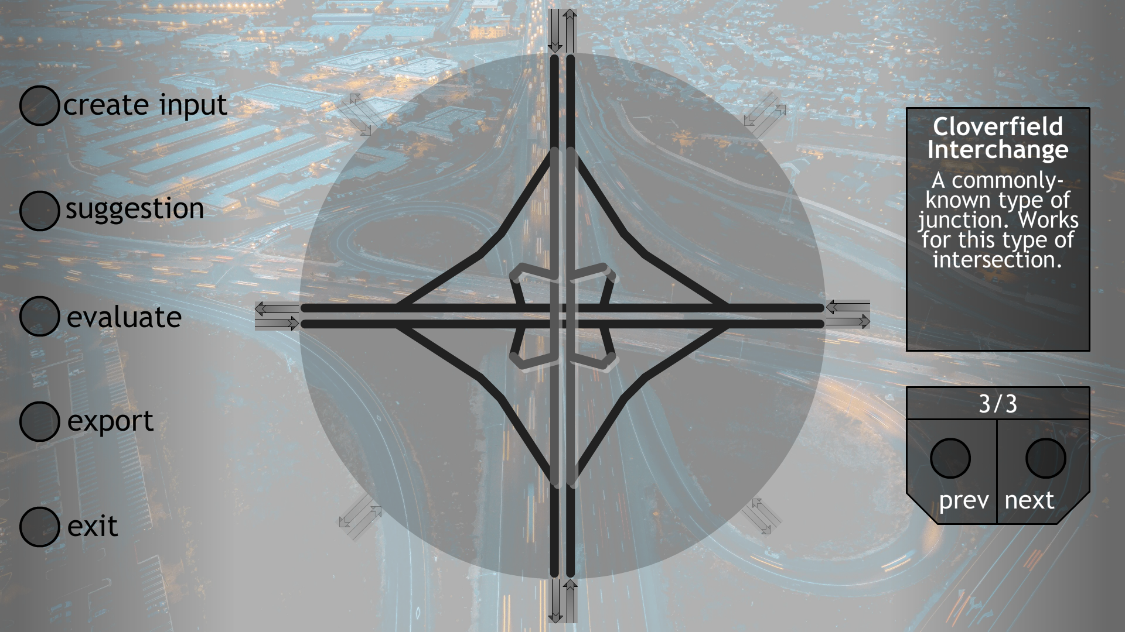

Slide 7


Slide 8


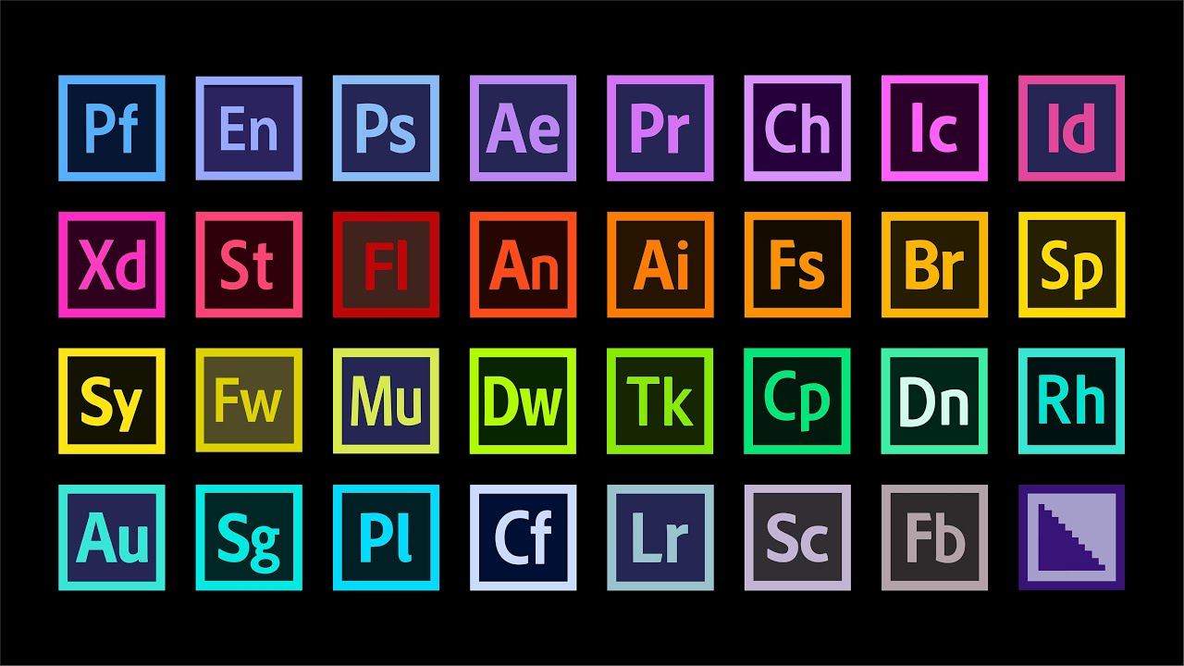

Slide 9
Connect! Then architect!

